Slide 1
The contribution of summer heatwaves to 'triploid mortality’ in the Pacific oyster
Aquaculture
3/01/2022
Matthew George, Ph.D.

Slide 2
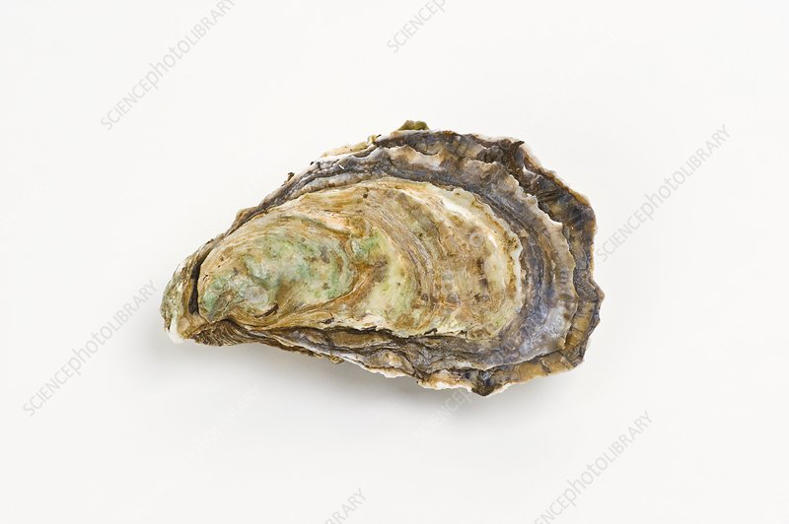

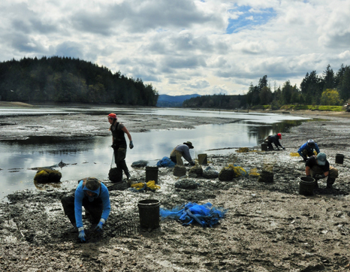
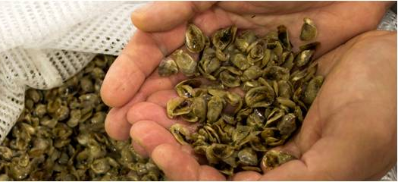
Pacific Oysters – tolerance is survival
Introduction
Pacific Oyster

Slide 3
Reproductive control in Pacific oysters
Introduction
Various methods used to induce triploidy (tetraploid cross, heat-shock, pressure, etc.) starting in the late 1970’s.
Triploid oysters have an extra chromosome set (3n).
Triploidy significantly reduces energetic investment in gonad production.
Triploid oysters have superior growth rates.
Harvesting triploids in the summer avoids the unpleasant taste of ‘spawny’ oysters.

Slide 4
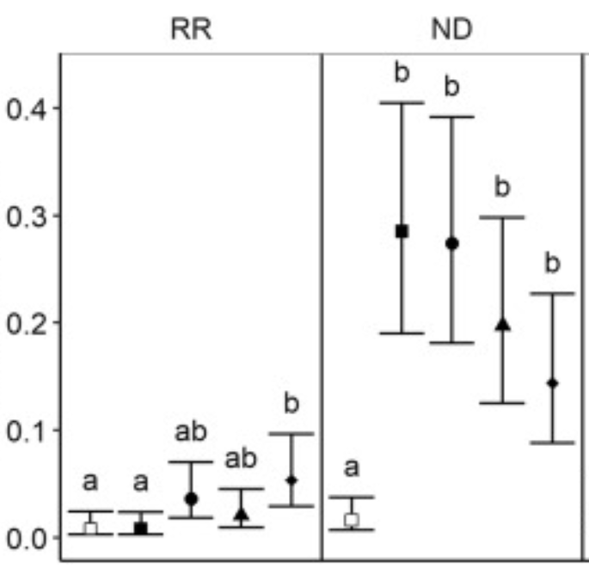
Diploid vs. Triploid mortality in the field
Introduction
Gulf of Mexico
Chesapeake Bay
Triploid
Cumulative mortality (%)
Probability of mortality
Field mortality extending through the summer
Diploid
Wadsworth 2018; http://hdl.handle.net/10415/6074
Matt et al. 2020; doi: 10.1016/j.aquaculture.2020.735375

Slide 5
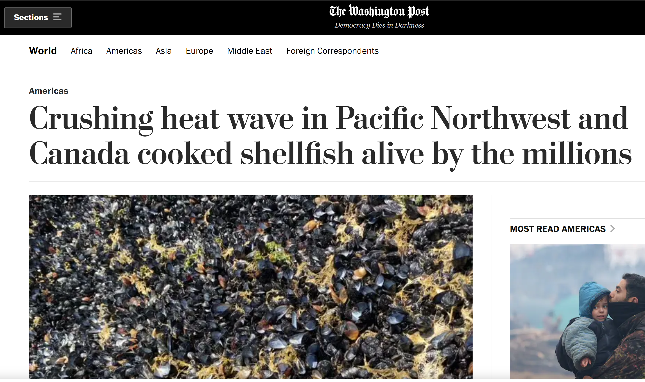
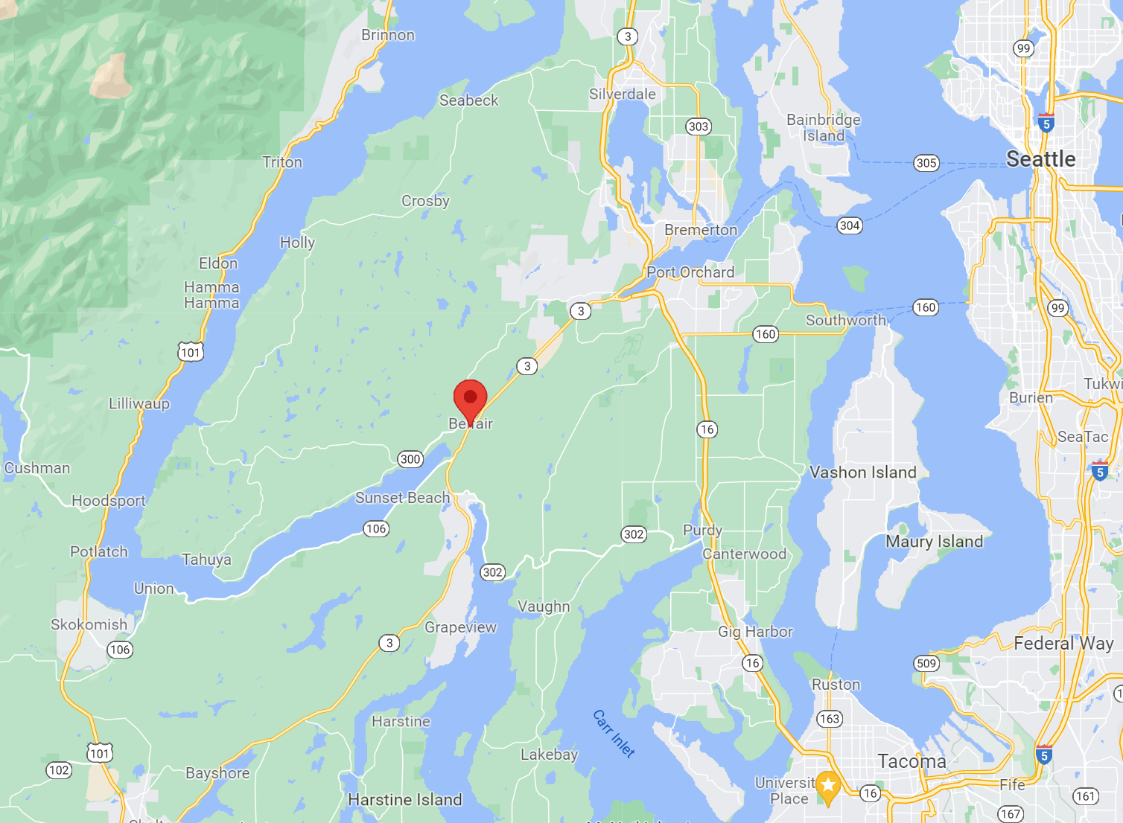
Marine Heatwaves
Introduction
June 2021
Air temp
40-45°
water temp
20-35°

Slide 6



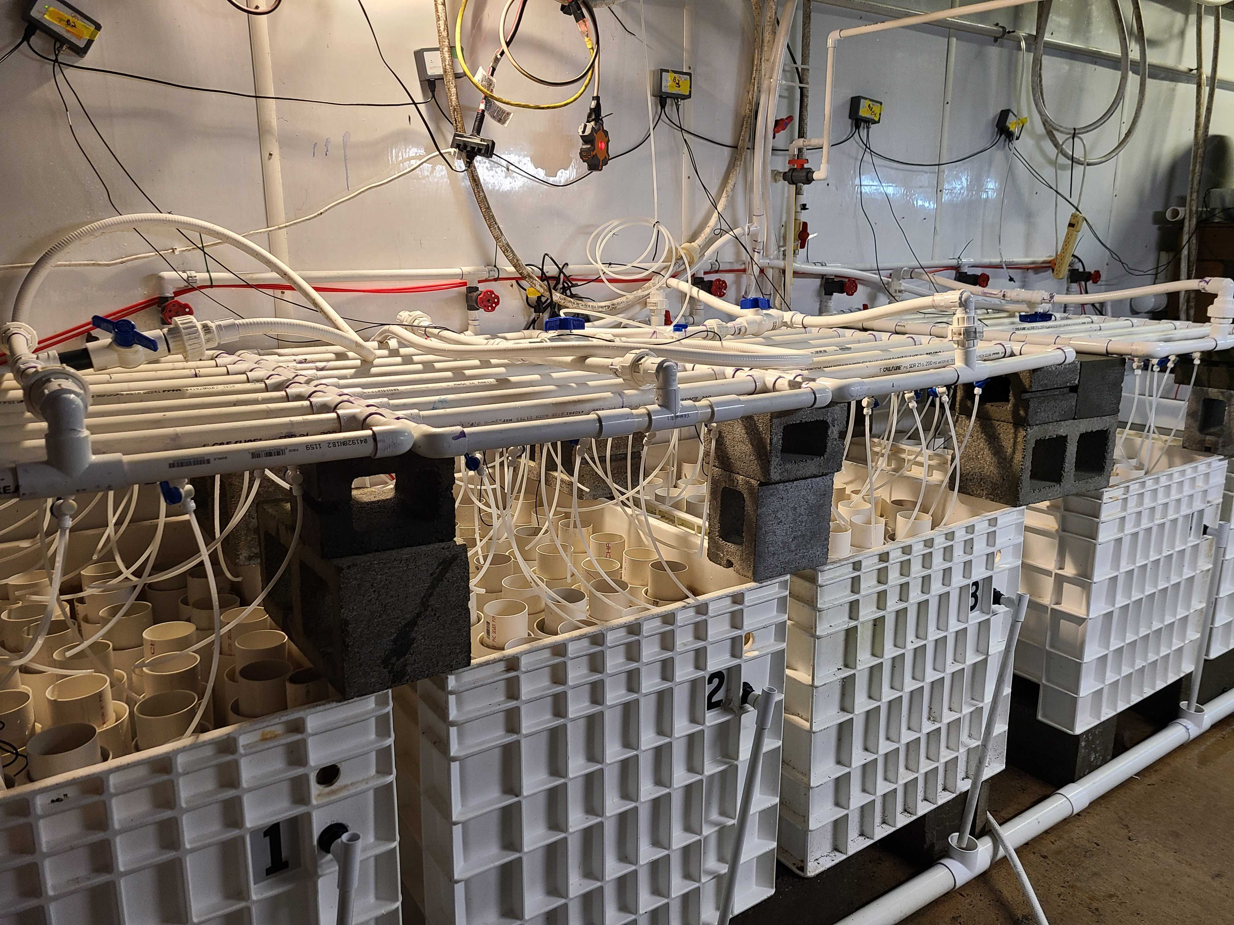
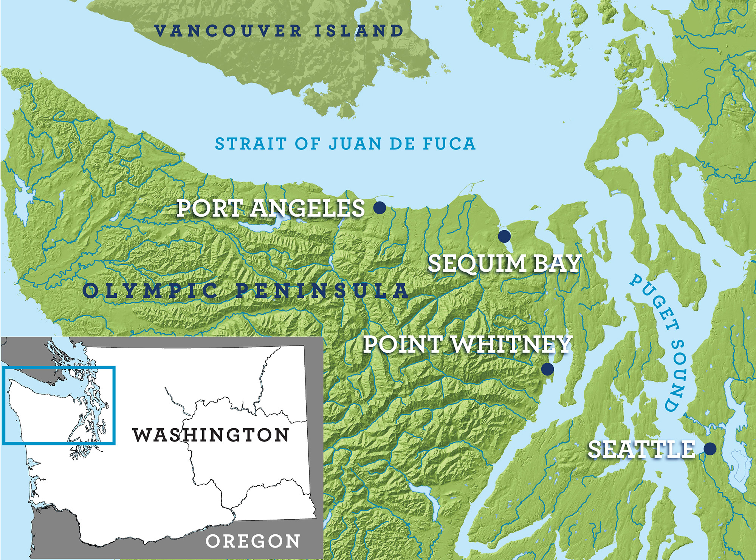
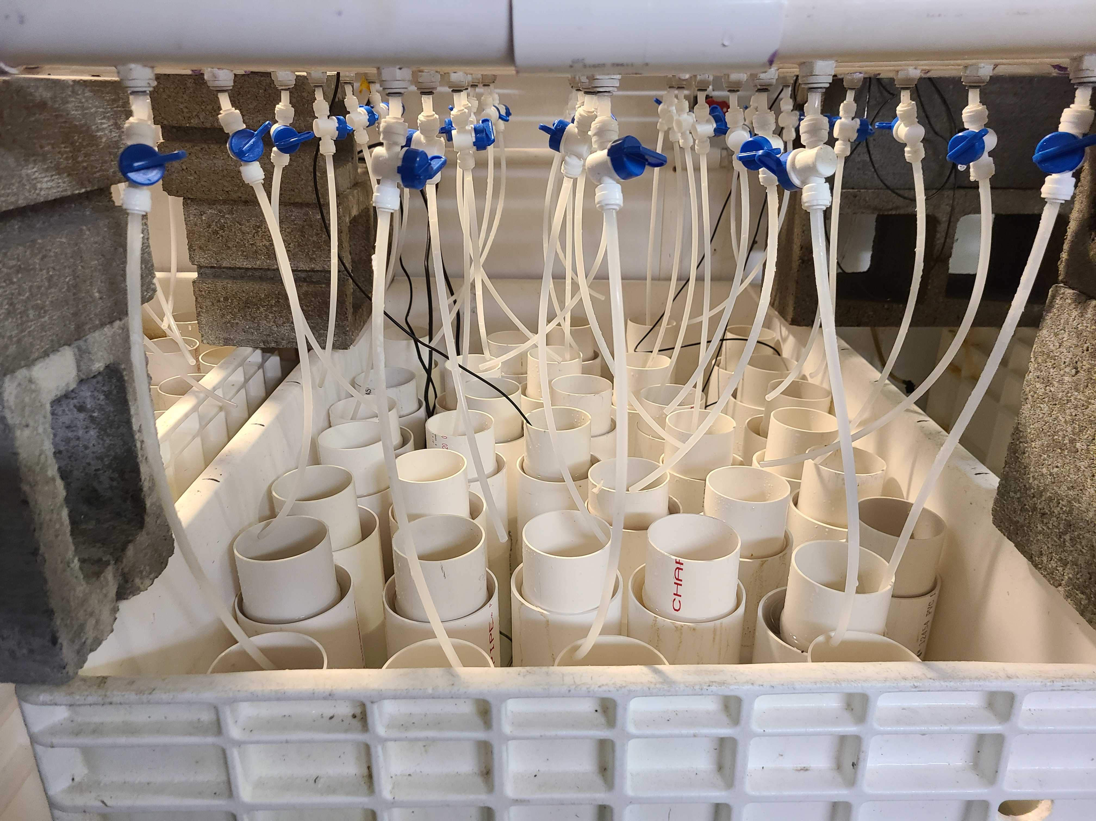
Point Whitney Shellfish Hatchery
Partners:

Slide 7
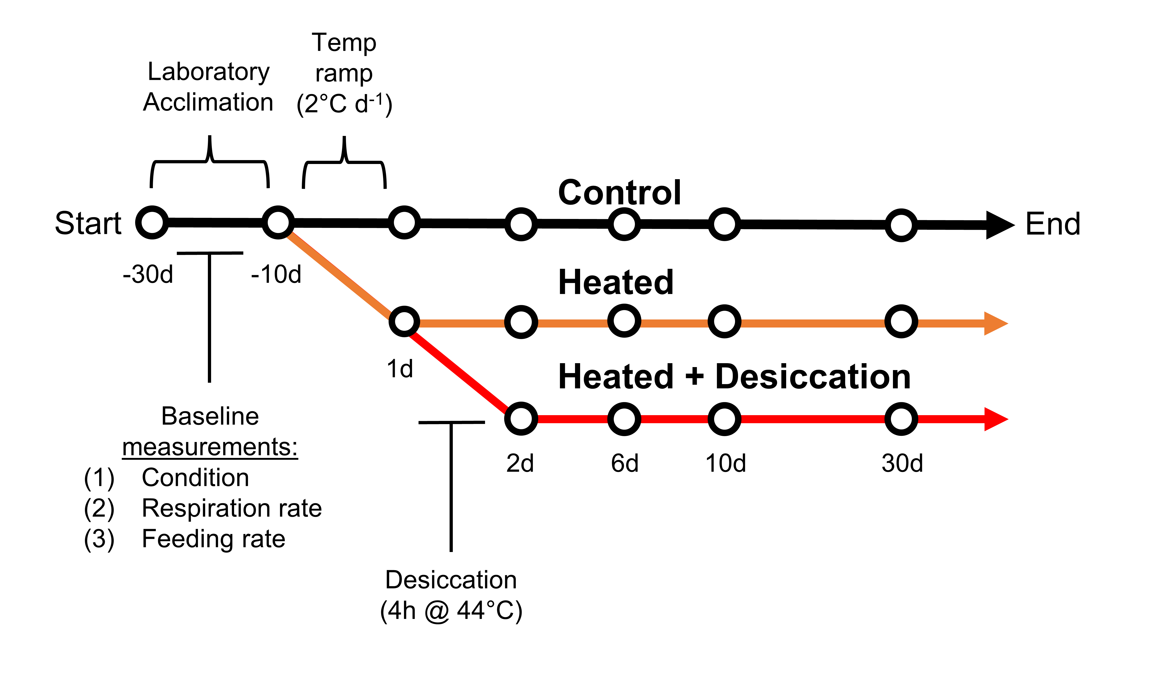
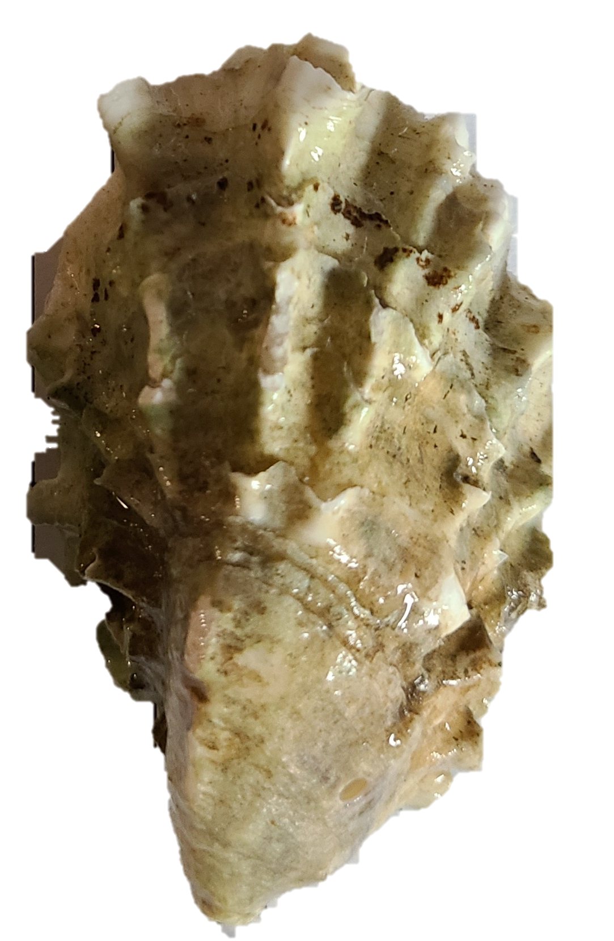
Experimental Design
Methods
(30°C)

Slide 8
Experimental Design
Methods
(30°C)

Slide 9
Experimental Design
Methods
(30°C)

Slide 10
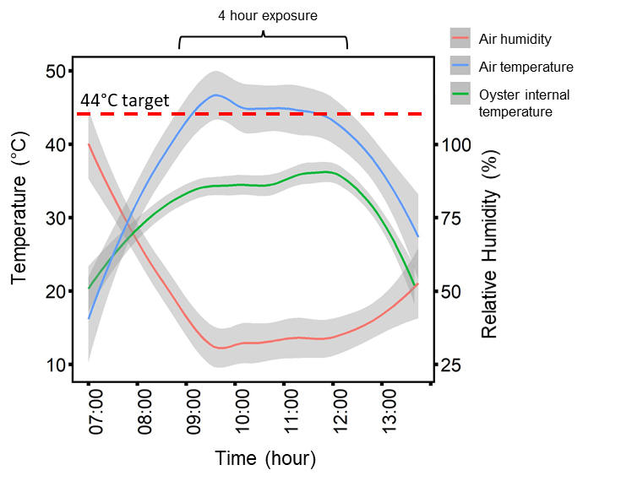
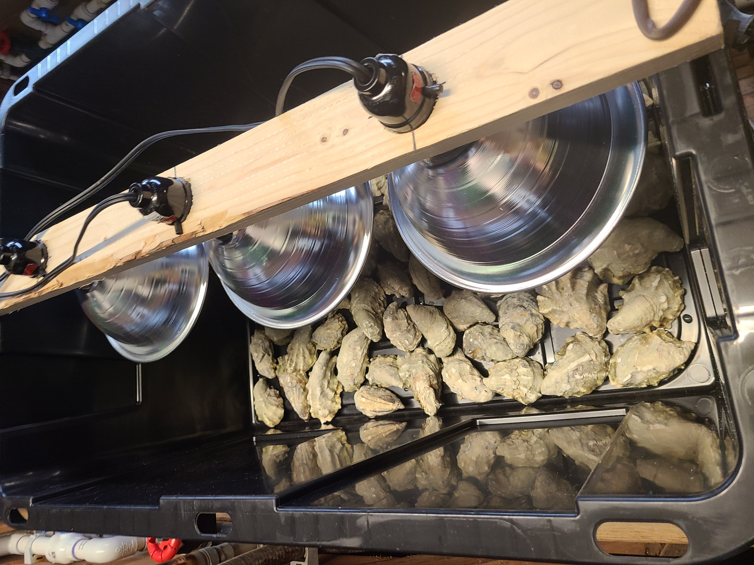
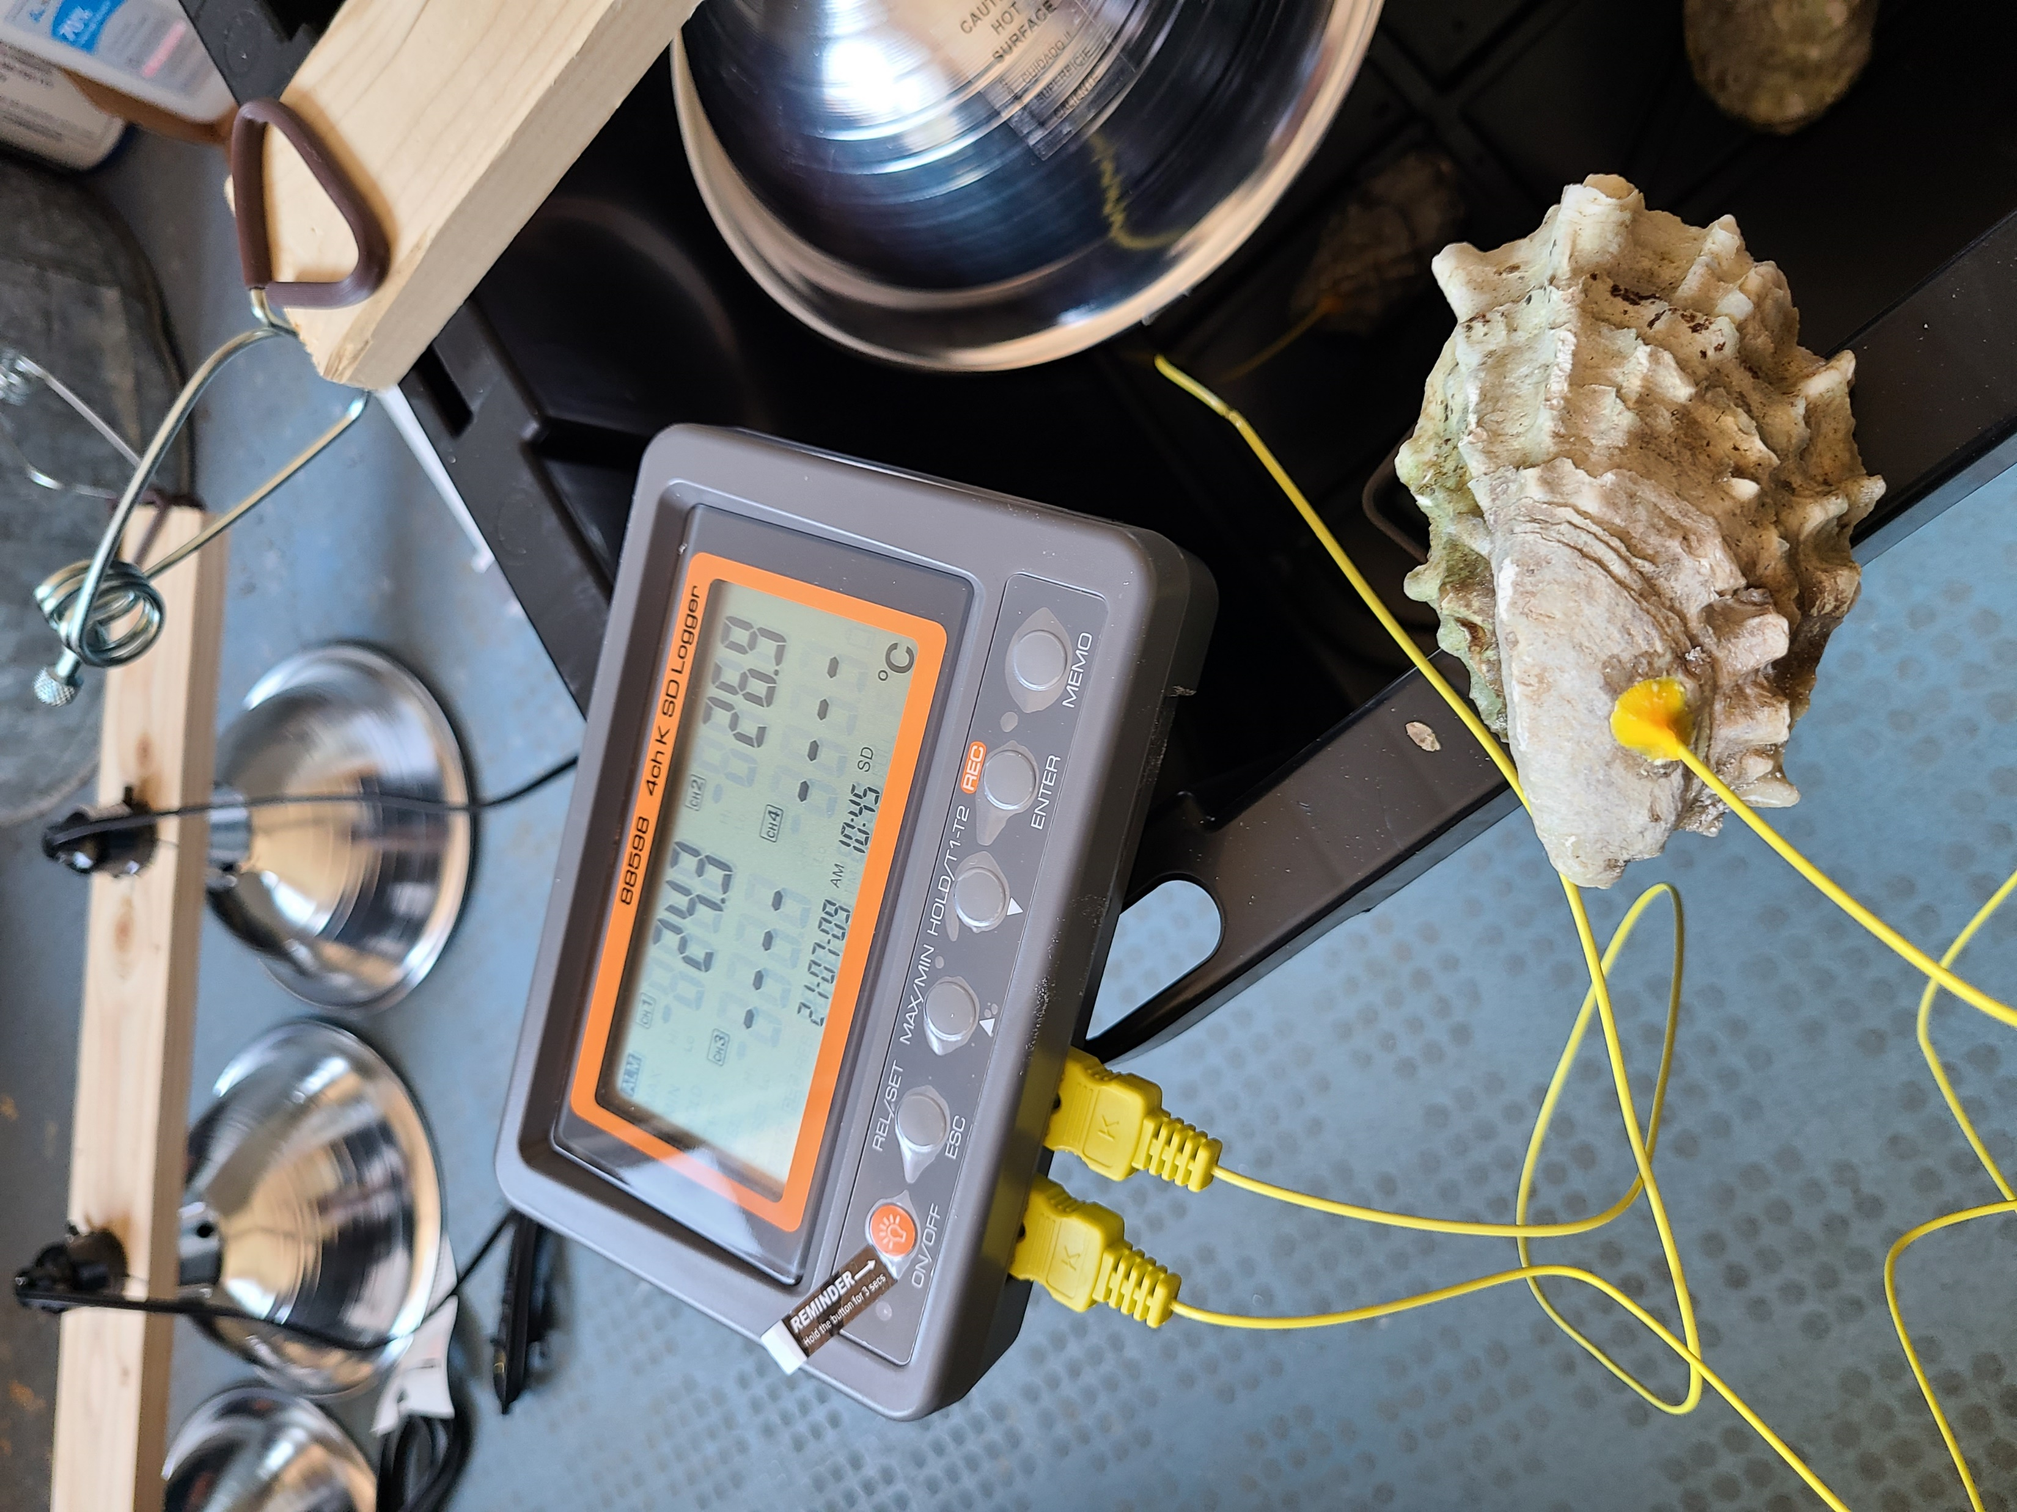
Desiccation
Methods

Slide 11
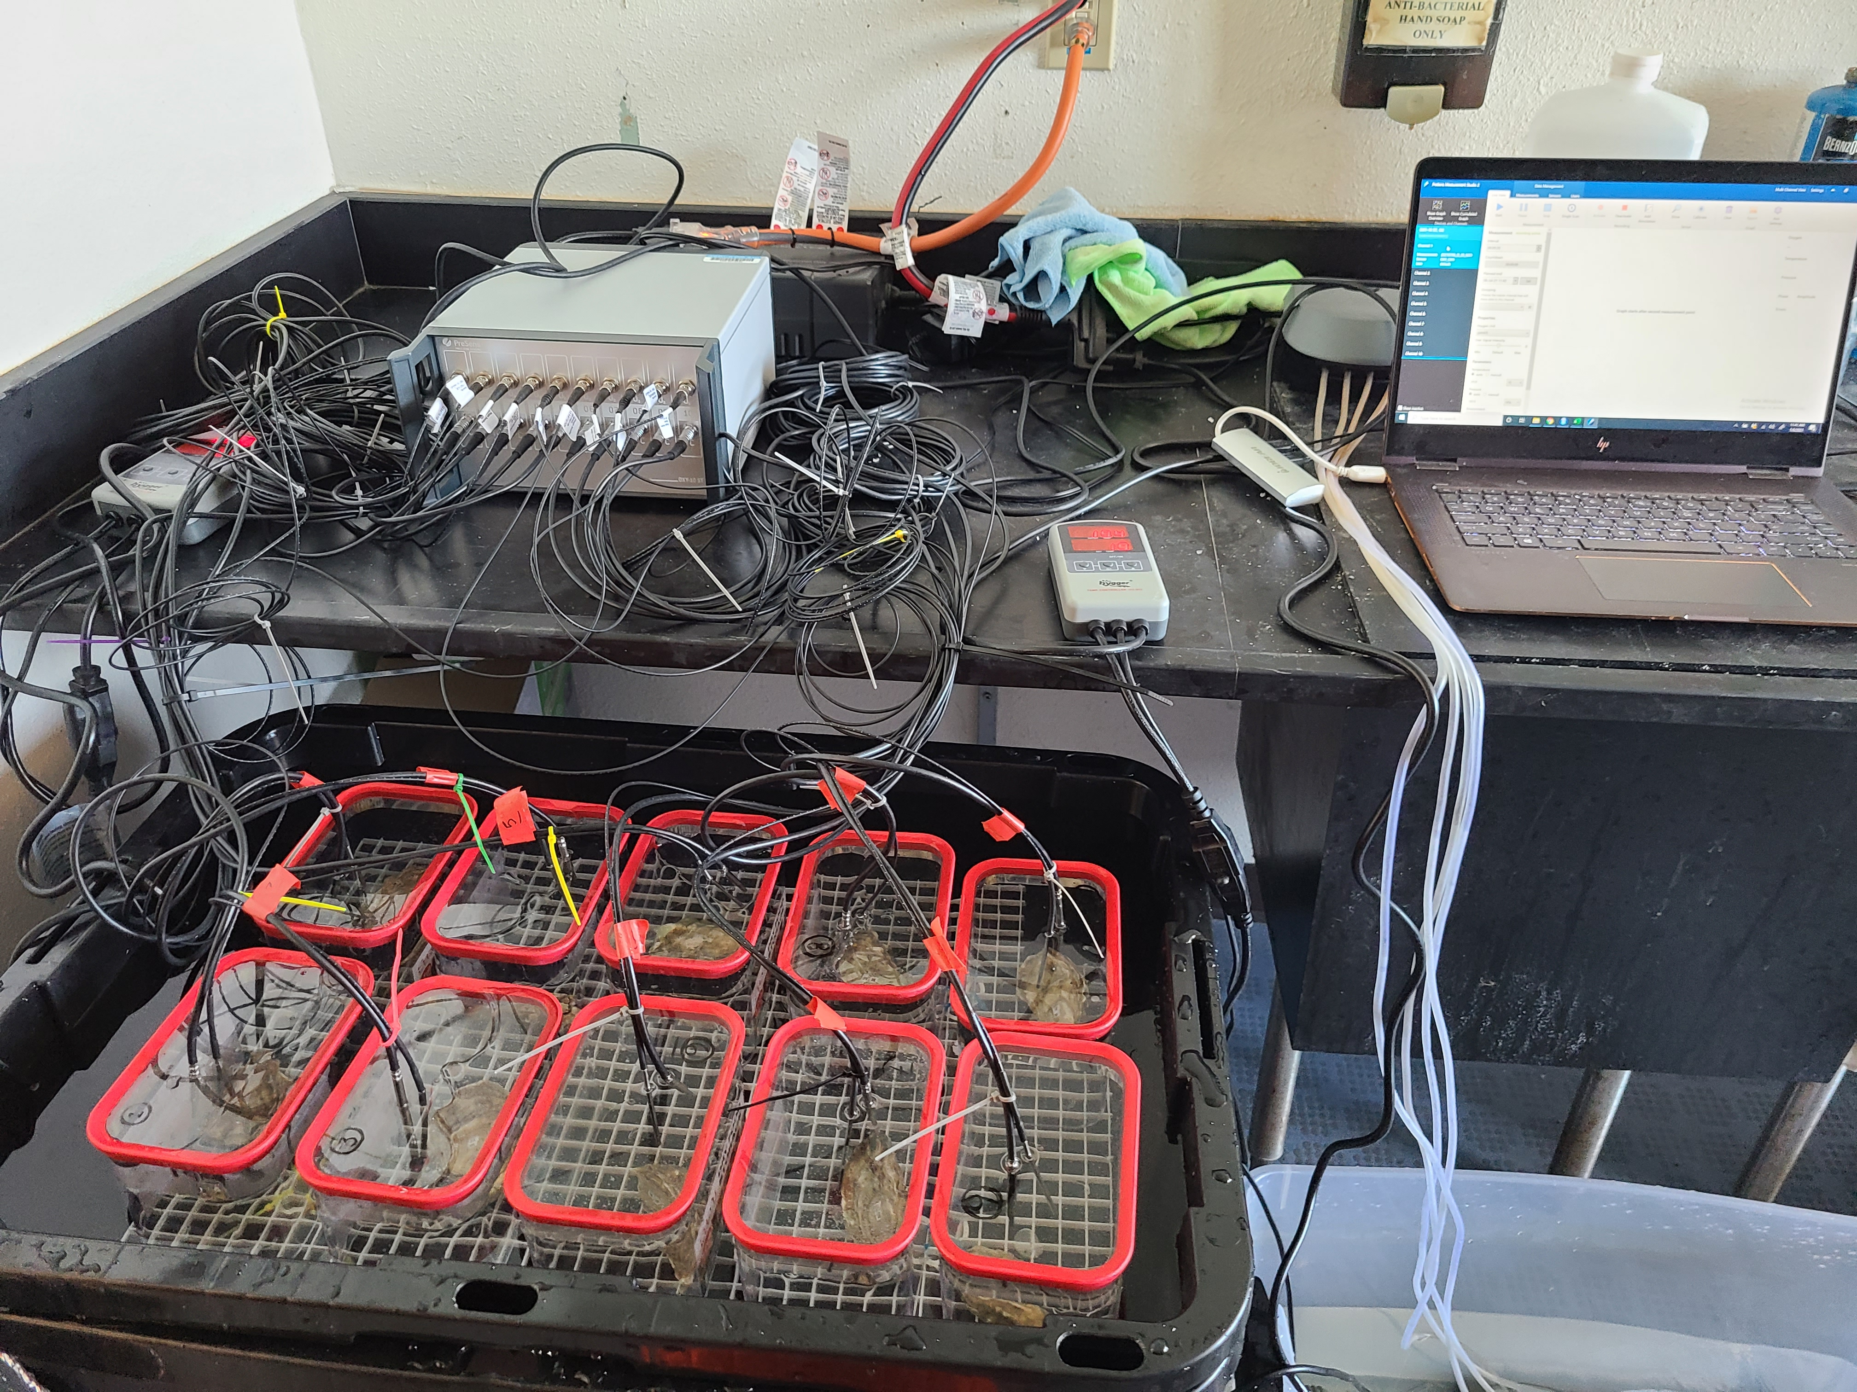
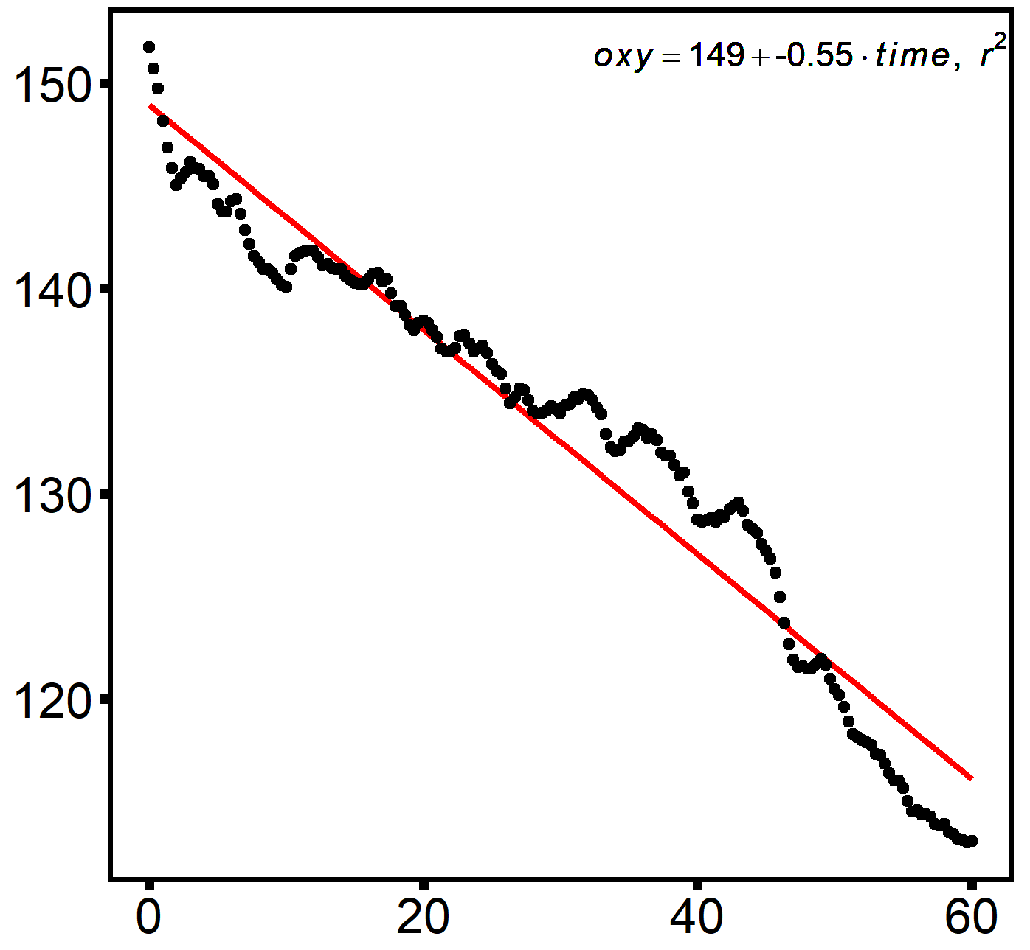
Respirometry
Methods
200
190
O₂ (µmol)
180
170
0
20
40
60
Time (min)

Slide 12

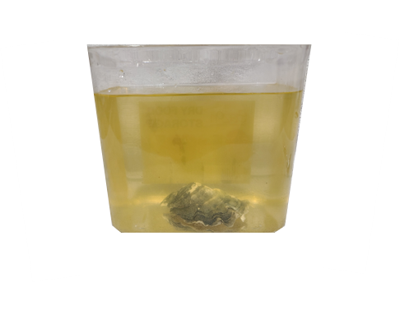
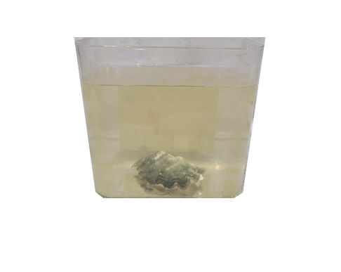
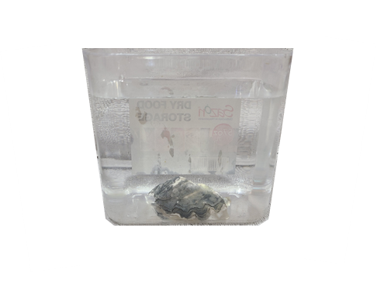

Clearance Rate
Methods
10⁶ cells ml⁻¹
10⁵ cells ml⁻¹
10² cells ml⁻¹
Clearance rate was defined as the amount of algae removed per unit time per oyster, corrected for oyster size

Slide 13
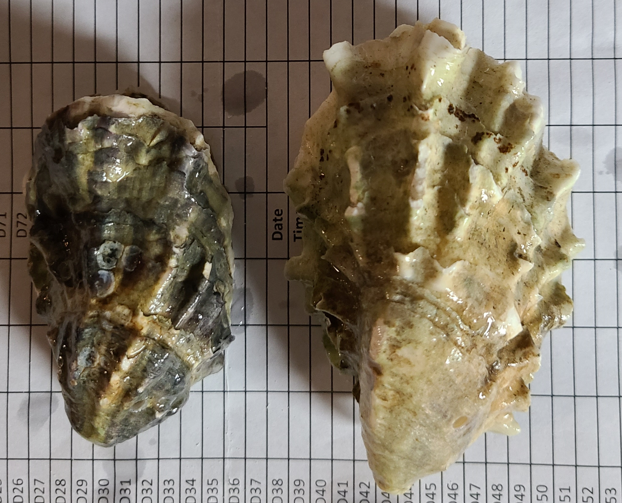
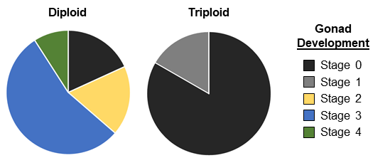
Reproductive Condition
Results

Slide 14
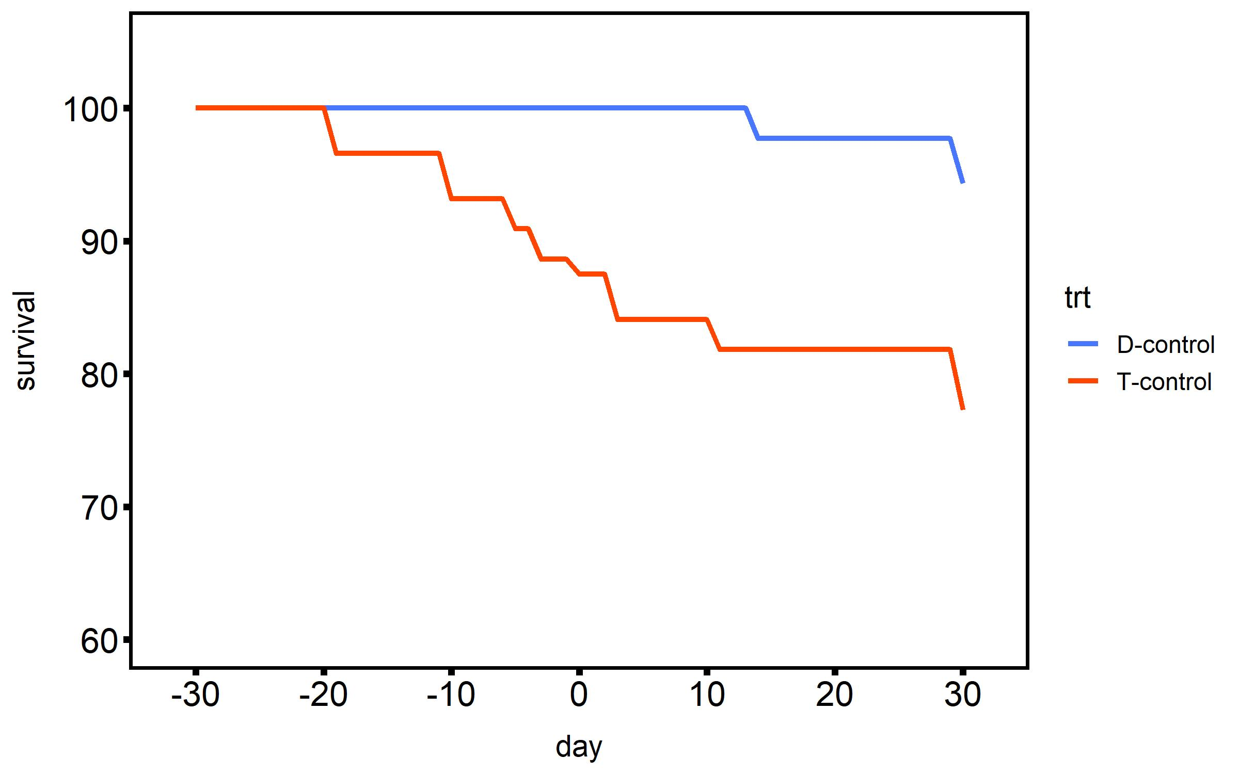
Mortality
Results
20°C
Treatment
2n - control
2n - heated
2n - heated +
desiccation
Survival (%)
3n - control
3n - heated
3n - heated +
desiccation
Timepoint (days heated)

Slide 15
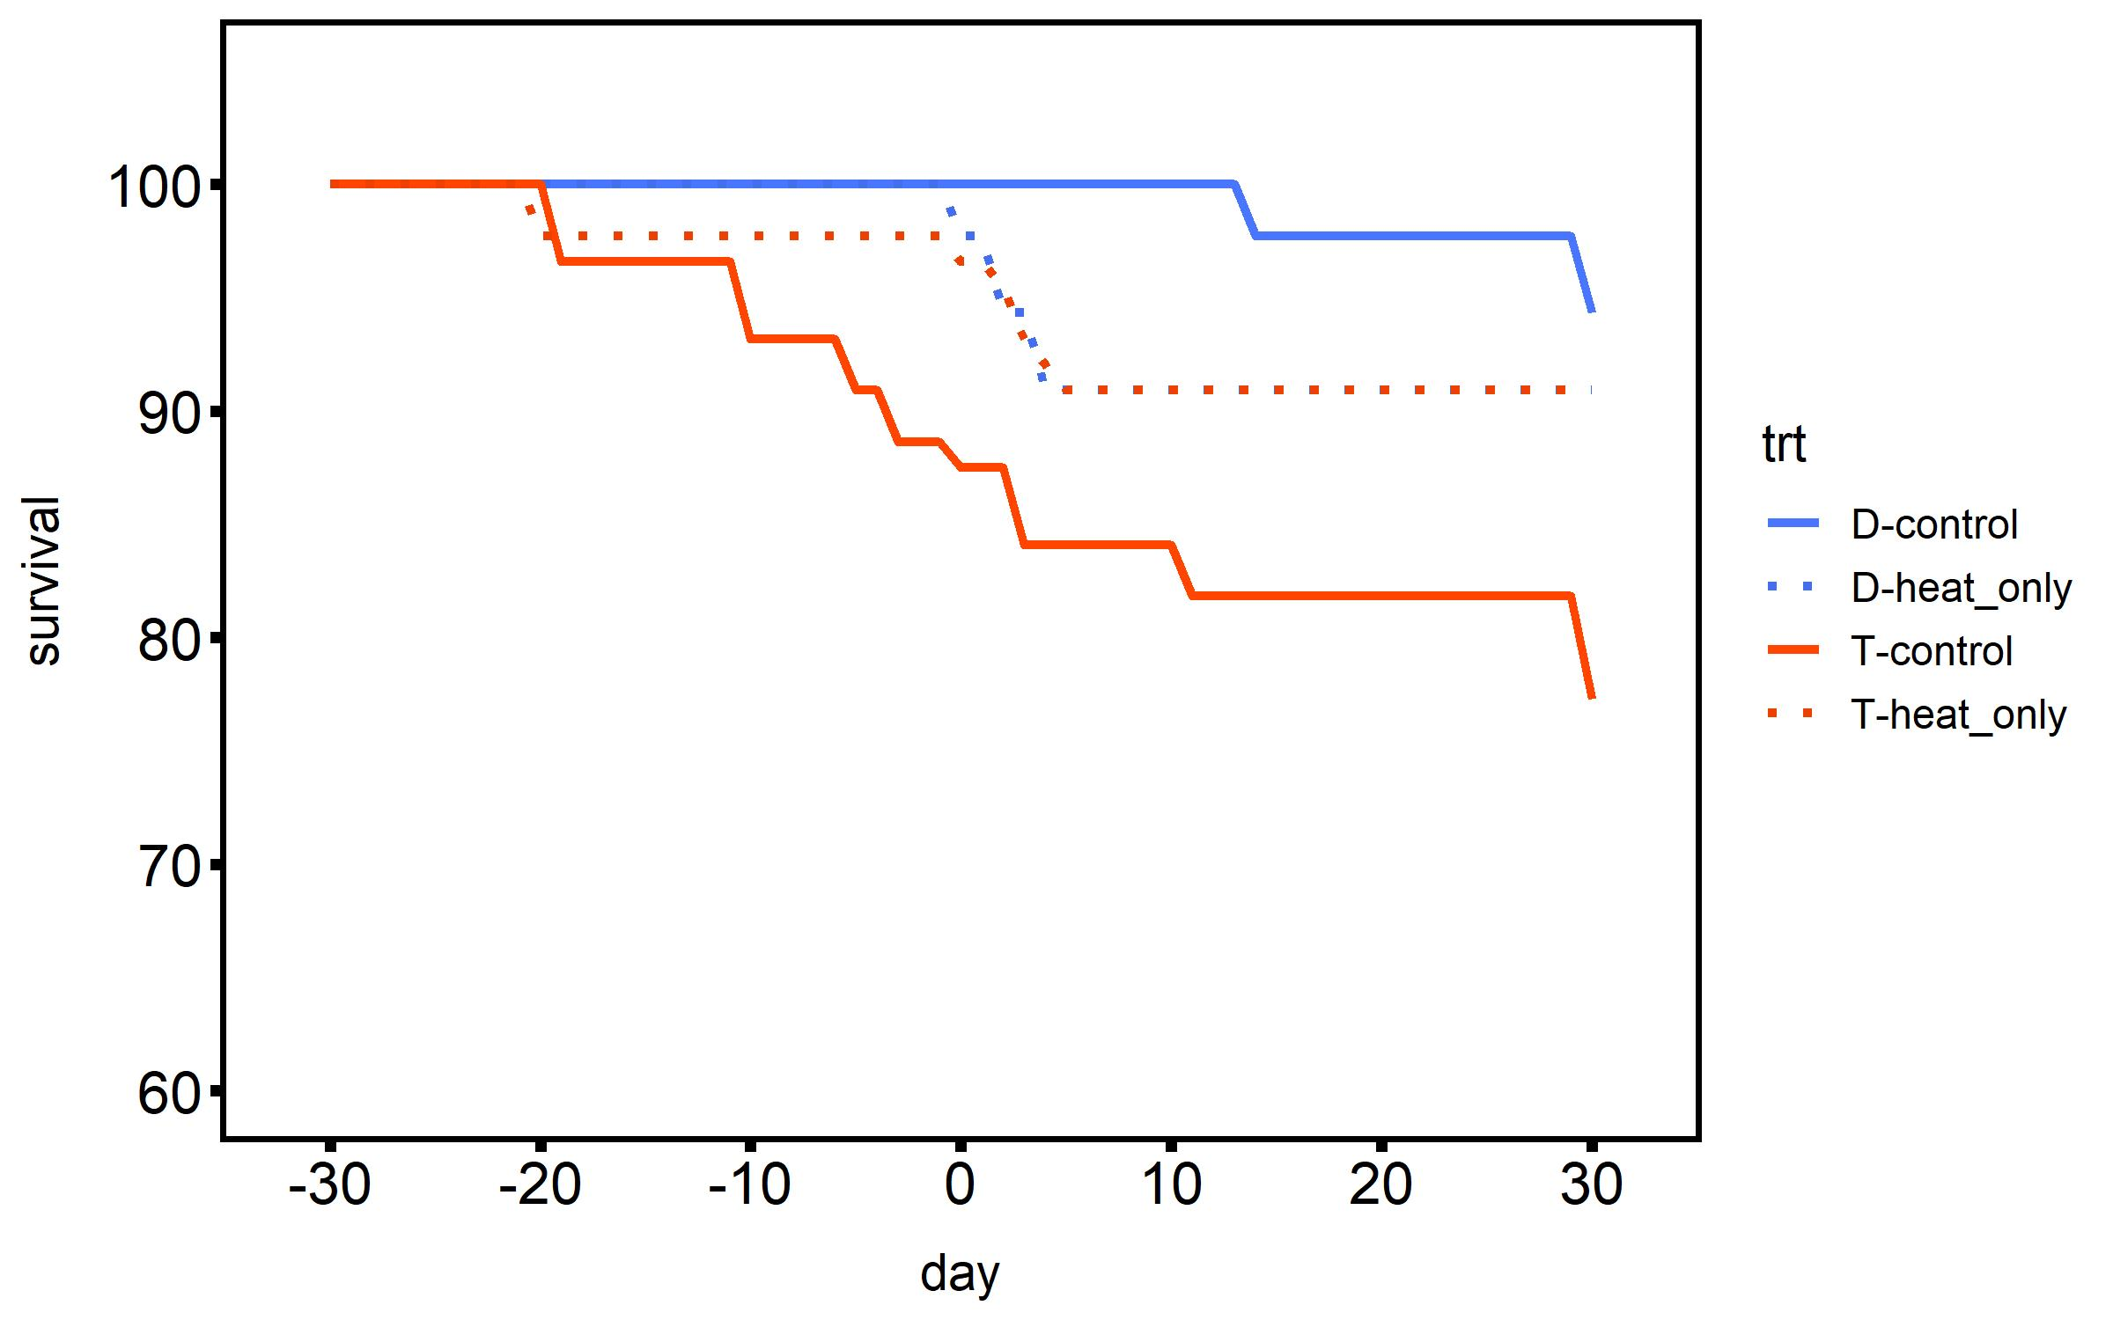
Mortality
Results
20°C
2°C d⁻¹ ramp
30°C
Treatment
2n - control
2n - heated
2n - heated +
desiccation
Survival (%)
3n - control
3n - heated
3n - heated +
desiccation
Timepoint (days heated)

Slide 16
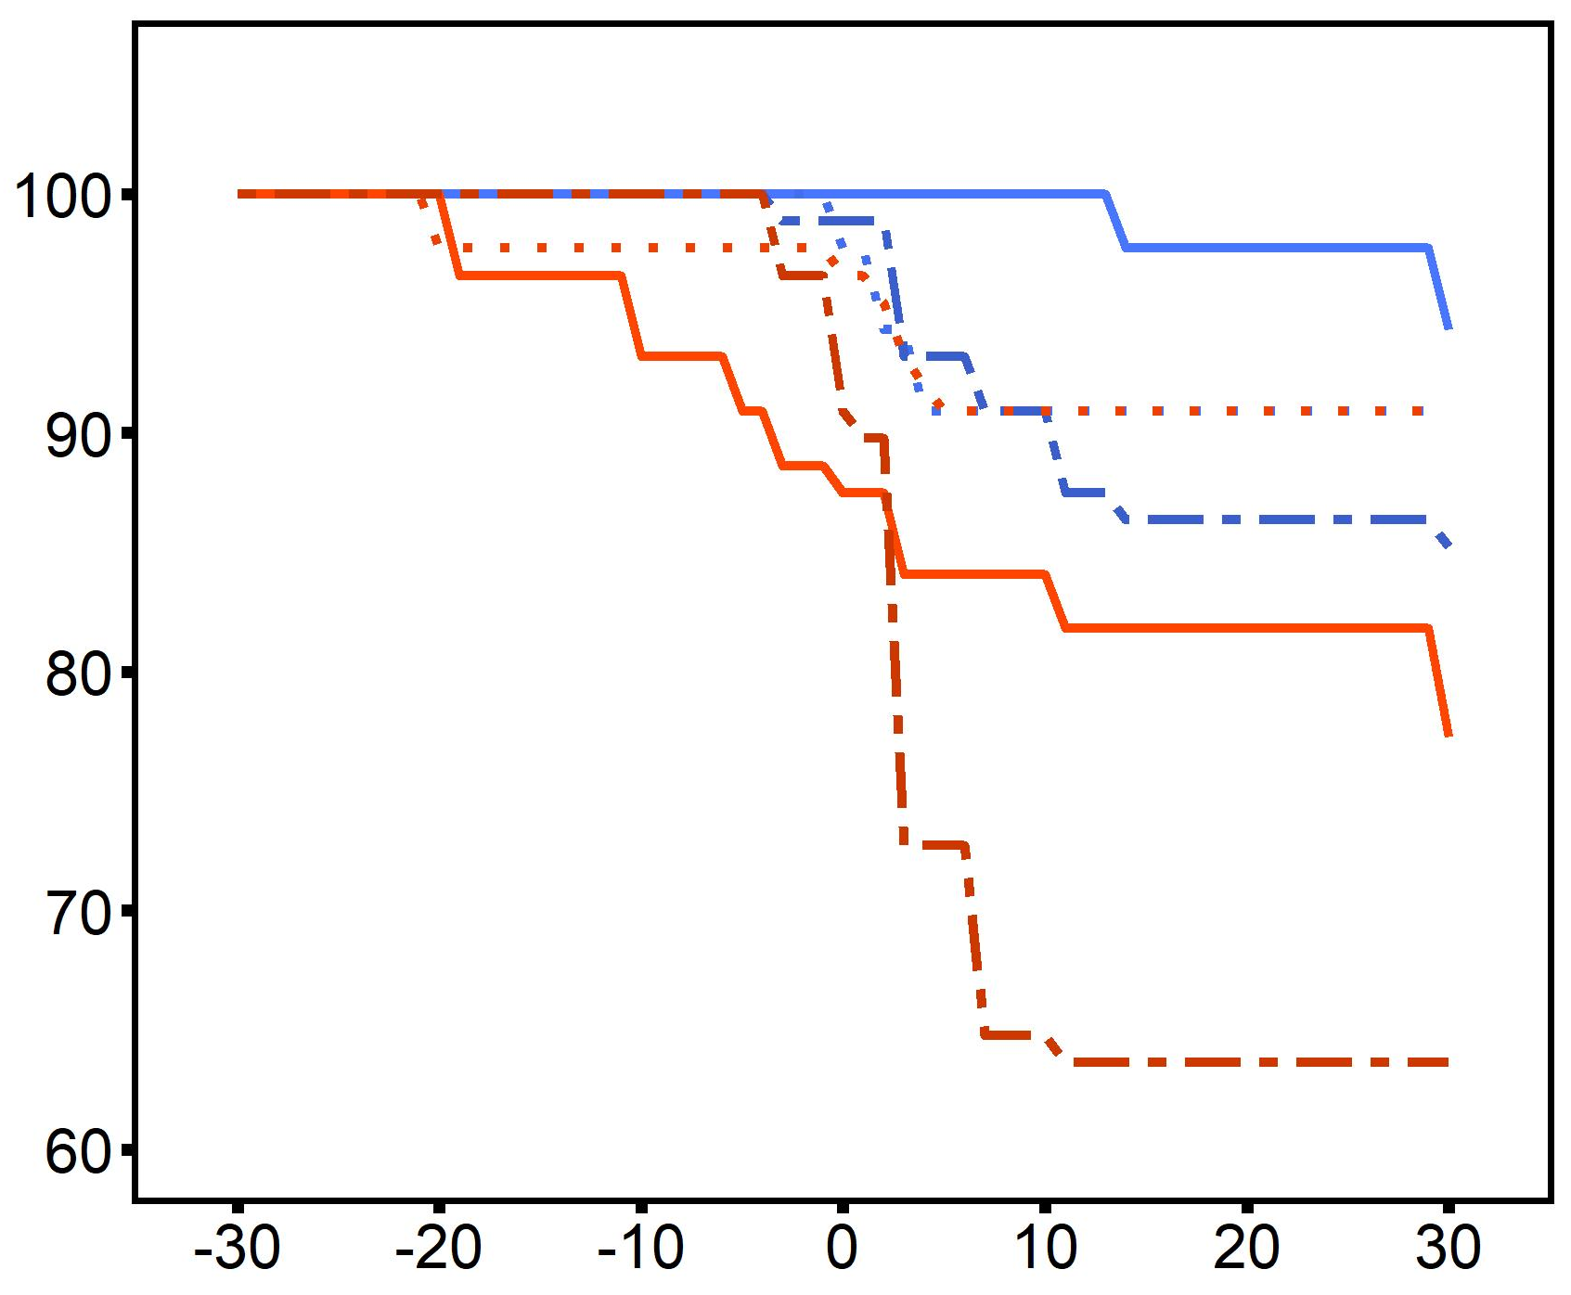
Mortality
Results
Desiccation
4 h @ 44°C
20°C
2°C d⁻¹ ramp
30°C
Treatment
2n - control
2n - heated
2n - heated +
desiccation
Survival (%)
3n - control
3n - heated
3n - heated +
desiccation
Timepoint (days heated)

Slide 17
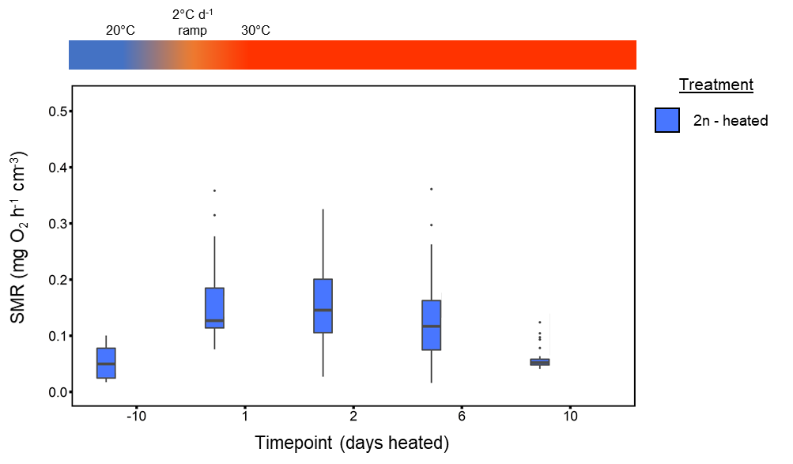
Metabolic Rate
Results
control

Slide 18
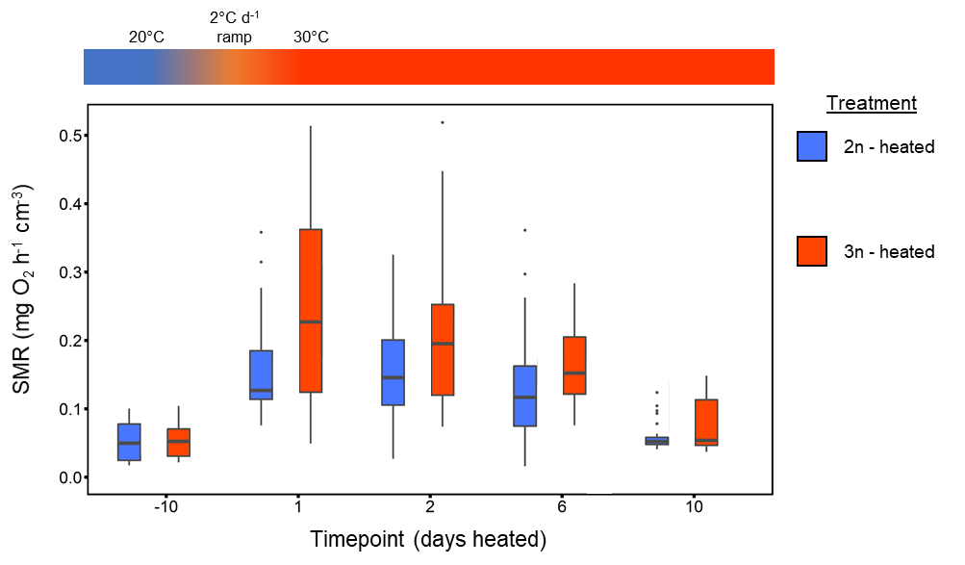
Metabolic Rate
Results
control

Slide 19
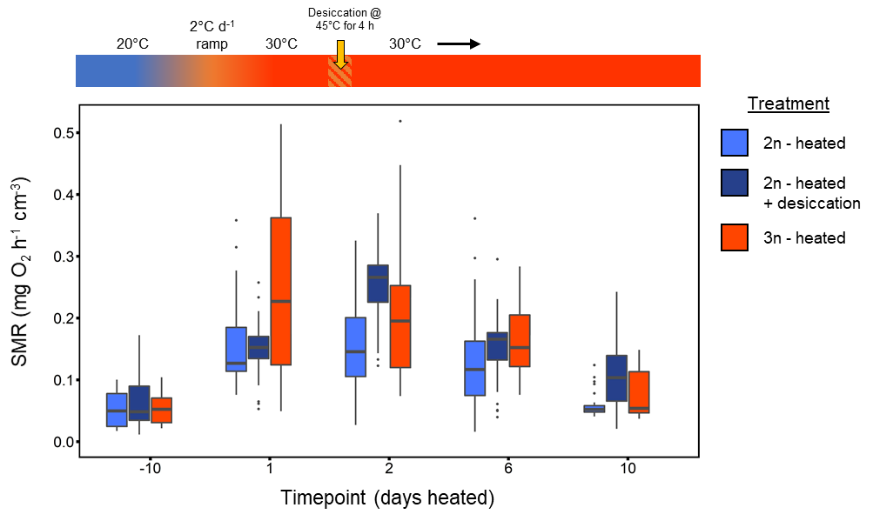
Metabolic Rate
Results
control

Slide 20
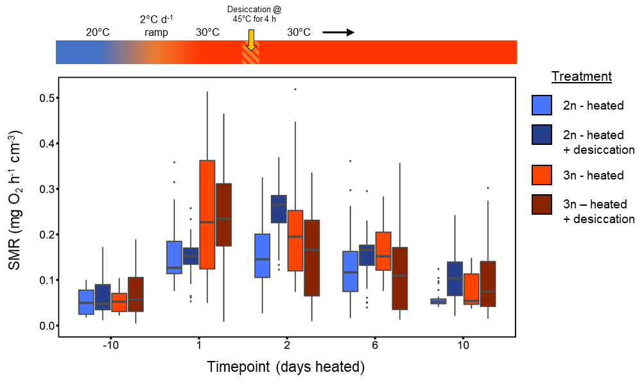
Metabolic Rate
Results
ploidy: p=0.003
time: p<0.001
ploidy×time: p=0.03
control

Slide 21
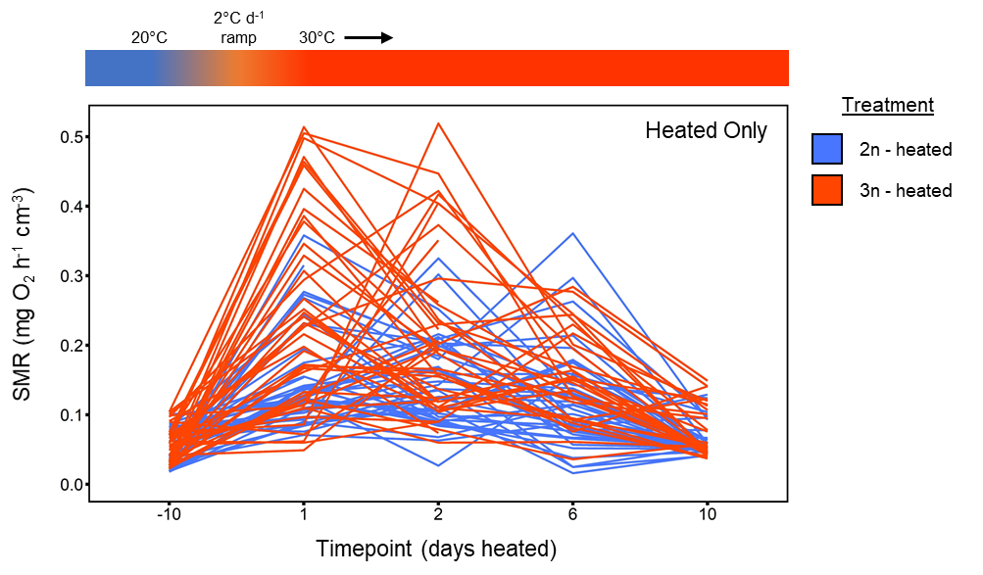
Heated
Results
control

Slide 22
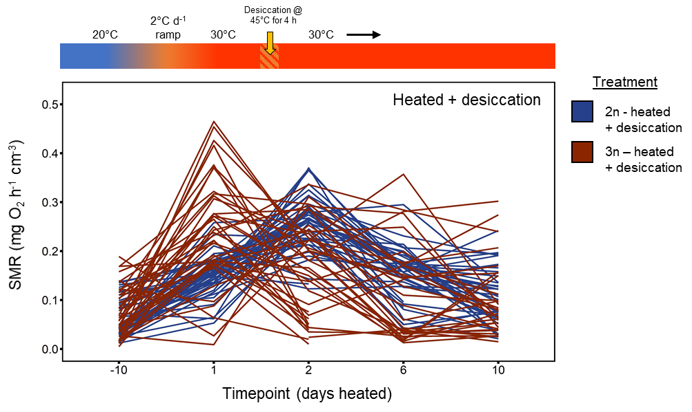
Heat + Desiccation
Results
control

Slide 23
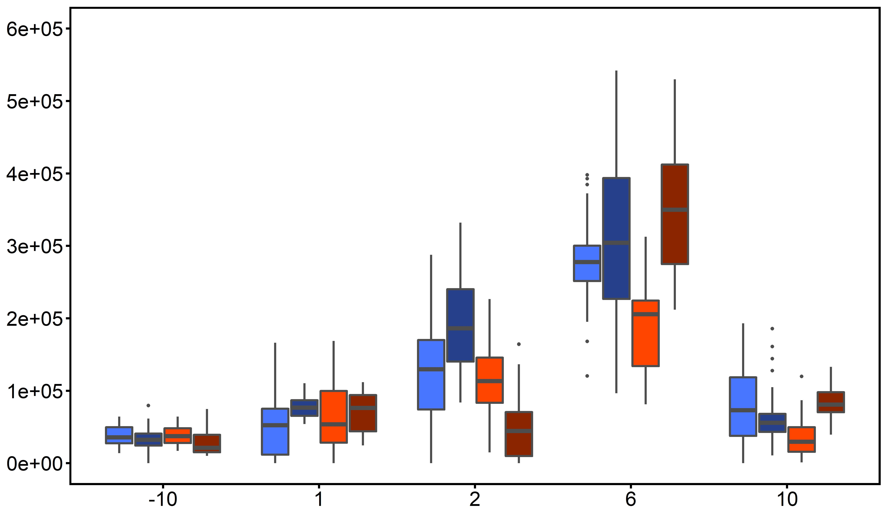
Clearance Rate
Results
ploidy: p<0.001
time: p<0.001
ploidy×time: p<0.001
Clearance Rate (cells ml⁻¹ h⁻¹ cm⁻¹)
control
Timepoint (days heated)

Slide 24
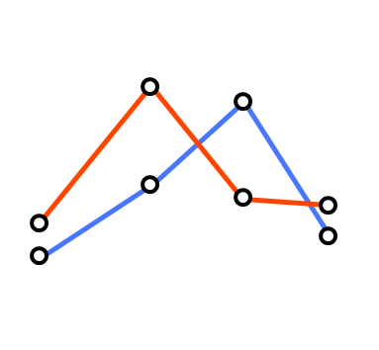

Summary
Results
Metabolism
Feeding
2n
3n
response
time
Recovery
Recovery
primary stressor
primary stressor
secondary stressor
secondary stressor

Slide 25
Conclusions
Conclusions
Heat stress alone did not result in mortality.
Multiple stressors (heat + desiccation) resulted in triploid mortality, although not at levels observed in the field.
Triploids underwent metabolic depression after multiple stress exposure
Triploids exhibit depressed feeding rates immediately after stress exposure.

Slide 26

Partners & Funding Sources

